Slide 1
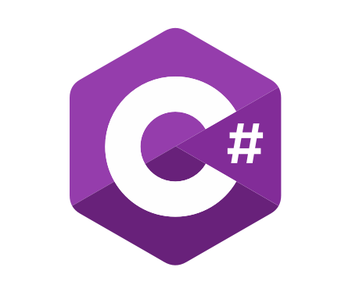
C# Advanced
Course Introduction
SoftUni Team
Technical Trainers
Software University
https://softuni.bg/

Slide 2
Table of Contents
Course Objectives
Training and Team
Course Organization
Course Infrastructure
Evaluation Criteria

Slide 3
Have a Question?
sli.do
#csharp-advanced

Slide 4














SoftUni Diamond Partners

Slide 5

Course Objectives

Slide 6
C# Advanced Module Goals
Working with linear data structures
Getting familiar with streams and files
Creating custom data structures
Building class hierarchies
Working with Exceptions
Applying principles and good practices for building quality software
Testing application correctness
6

Slide 7
C# Advanced Course Goals
Working with linear data structures
Stacks, Queues and Multidimensional Arrays
Getting familiar with streams and files
Creating custom data structures
List, Stack and LinkedList
Simple algorithms
Recursion, Sorting and Searching
7

Slide 8
Practical Programming Exam
3 practical problems for 4 hours
The first two problems may include:
Stacks and Queues
Multidimensional Arrays
Dictionaries
Defining Classes
Automated judge system
http://judge.softuni.bg
Solutions are evaluated for correctness only
Code quality is still not measured
8

Slide 9
Theoretical Exam
You will have 30 minutes once you enter
Multiple-choice with 1 or more correct answers
English
Automated quiz system
Available during the practical exam and 30 minutes after it
You can submit your answers just one time
Advice: Start it when you finish the practical exam
9

Slide 10

The Team

Slide 11
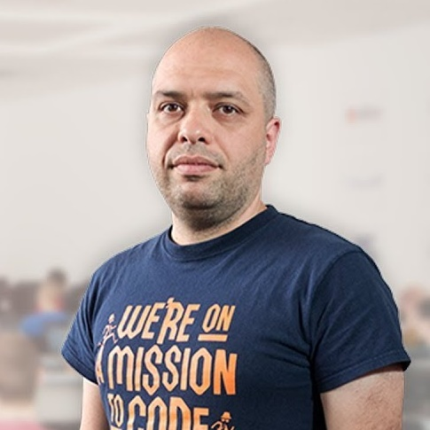
Stamo Petkov
Head Of Department at Information Services Plc.
Worked with various technologies
.NET and C#, BASIC, Pascal, Object Pascal, PHP
More than 15 years of experience
Experienced Lecturer
C# Basics and ASP.NET MVC @ Softuni

Slide 12
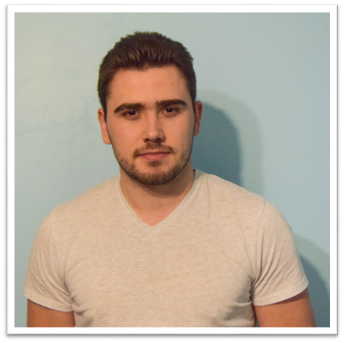
Slavi Kapsalov
Technical Trainer @ SoftUni
Graduated the C# Track
Team Lead @ SoftUni
Involved in "Projects SoftUni" – ASP.NET Core Web Project
Experience with C#, Java, PHP and Python
Deep interests in automation of processes

Slide 13

Course Organization

Slide 14
C# Advanced Module – Timeline
19-May-2020
28-june-2020
30-June-2020
16-August-2020
C# Advanced
6 weeks * 4 times / week
12 credits
Start: 19-May-2020
Theoretical Exam: 28-June-2020
Practical Exam: 28-June-2020
Theoretical Exam Retake: 19-August-2020
Practical Exam Retake: 19-August-2020
C# OOP
7 weeks * 4 times / week
15 credits
Start: 30-June-2020
Theoretical Exam: 16-August-2020
Practical Exam: 16-August-2020
Theoretical Exam Retake: 22-August-2020
Practical Exam Retake: 22-August-2020

Slide 15

Homework Assignments & Exercises
Your homework is mainly work in class
Lesson days → slides + live demos + exercises
Exercise days → only exercises
How to submit your homework?
Submitted in the judge system
Do your homework when it's due
Assignments pile up quickly

Slide 16


Scoring System for the Course
Theoretical Exam 5%
PracticalExam 90%
Evaluation
Homework 5 %
16

Slide 17



Course Web Site, Forum and FB Group
Official web site:
Official discussion forum:
Official Facebook group:
Community Facebook group:
https://softuni.bg/courses/csharp-advanced/
https://softuni.bg/forum/categories/30/
https://www.facebook.com/groups/CsharpAdvancedMay2020/
https://www.facebook.com/SoftUniCSharpCommunity/

Slide 18
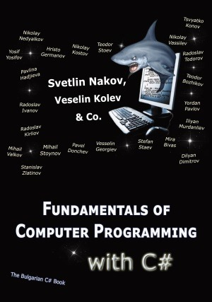

The Free C# Fundamentals Textbook
The official textbook for the course
"Fundamentals of Computer Programming with C#", by Svetlin Nakov & Co., 2013, ISBN 9789544007737
English and Bulgarian versions (as PDF, ePub, …)
Freely downloadable from: www.introprogramming.info
The C# Programming courses @SoftUni.bg partially follows the book

Slide 19
Questions?
Notes:
19

Slide 20
Trainings @ Software University (SoftUni)
Software University – High-Quality Education, Profession and Job for Software Developers
softuni.bg, about.softuni.bg
Software University Foundation
softuni.foundation
Software University @ Facebook
facebook.com/SoftwareUniversity
Software University Forums
forum.softuni.bg
20
Notes:
20

Slide 21

License
This course (slides, examples, demos, exercises, homework, documents, videos and other assets) is copyrighted content
Unauthorized copy, reproduction or use is illegal
© SoftUni – https://about.softuni.bg/
© Software University – https://softuni.bg
Notes:
21

